Slide 1
Introduction to Digital Manufacturing Smart Factory Connected Manufacturing Brilliant Manufacturing

Slide 2
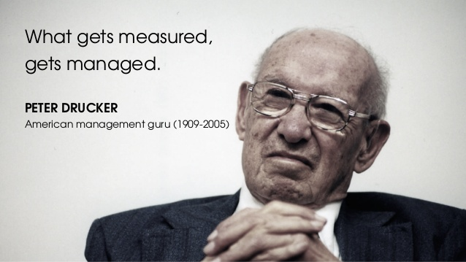

Slide 3
Digital Manufacturing?? What could it mean?

Slide 4
Get Connected Get Insights Get Optimized

Slide 5
Get Connected
Real-time visibility and deep operational intelligence
Maximize utilization → Improved production capacity
Reducing costs
Maximizing uptime
Can understand what drives:
OEE
Equipment downtime
Reduce scrap/wastage

Slide 6
Get Connected

Slide 7
Challenge: Increase Asset Utilization

Slide 8
Challenge: Minimize Rework

Slide 9
Challenge: Identify Faulty Equipment

Slide 10
Challenge: Identify Operators that need training

Slide 11
GET INSIGHTS

Slide 12
GET INSIGHTS??

Slide 13
Deliver the right information to the right people at the right time
GET INSIGHTS

Slide 14
Clerical Burden Make information *part* of the process

Slide 15
Information leads to Insights
GET INSIGHTS
Power Consumption
ENVIRONMENTAL CONDITIONS
SAFETY
PRODUCT QUALITY
OPERATIONAL EFFICIENCY
ON-TIME PERFORMANCE
SCHEDULE
RESOURCES

Slide 16
Fragmented Data Lack of visibility ACROSS processes No WIP Visibility Resistance to change
WHY IS THIS DIFFICULT?

Slide 17
Get Optimized

Slide 18
Get Optimized ??
What do we mean by this…?

Slide 19
Optimize
All TYPES oF ASSETS
Machines
LABOR UTILIZATION
MATERIALS

Slide 20
Optimize
END-TO-END OPTIMIZATION
DESIGN → ENGINEERING → SUPPLY CHAIN → MANUFACTURING → DISTRIBUTION → POST-SALES SERVICE
CONNECT EVERYTHING VIA INFORMATION

Slide 21
Used to Self-Improve products and processes within the system to provide continuous feedback, allowing for real-time reallocation of resources to optimize efficiency.

